Slide 1
Welcome to IT 372!

Slide 2
Software Maintenance & Software Evolution
IT 372

Slide 3
Software Maintainance (Fred Brooks, No Silver Bullet)
All successful software gets changed. Two processes are at work. First, as a software product is found to be useful, people try it in new cases at the edge of or beyond the original domain. The pressures for extended function come chiefly from users who like the basic function and invent new uses for it.
Second, successful software survives beyond the normal life of the machine vehicle for which it is first written. If not new computers, then at least new disks, new displays, new printers come along; and the software must be conformed to its new vehicles of opportunity.

Slide 4
One Definition of Software Maintenance
IEEE Standard 610.12-1990, IEEE Standard Glossary of Software Engineering Terminology
IEEE Standard 1219-1998, IEEE Standard for Software Maintenance
Software maintenance is the process of modifying a software system or component after delivery to correct faults, improve performance, or other attributes, or adapt to a changed environment.

Slide 5
Program Theme
We are software developers: professional software designers.
Creative
Critical
Knowledgeable
Responsible
Accountable

Slide 6
The Problem
Building software well is hard, very hard
Consequences
Software is expensive
Productivity is poor
Reliability is poor
But lots of software is needed

Slide 7
The Problem, continued
Software cost is increasing as hardware costs decrease.
Many software development disasters:
Cost overruns, late delivery
Reduced or wrong functionality
Non-existent documentation
Many failures attributed to software
Cost of failure becoming very high:
Financial
Loss of life or loss of equipment
Inconvenience and loss of productivity

Slide 8
Software Engineering
Termed coined at NATO conference
Software Engineering
Garmisch, Germany
October 7-11, 1968
Definition (Fairley)
Software engineering is the technological and managerial discipline concerned with systematic production and maintenance of software products that are developed and modified on time and within cost estimates.

Slide 9
Software Engineering
Software engineering is:
Engineering
Building software systems
Modifying software systems
A systematic, careful, scientific activity
Software engineering is not:
Just programming
Just building small systems
Building new systems
Hacking
Debugging until it works

Slide 10
Software Engineering
The Software Engineer:
Is an engineer
Rarely works in isolation
Is responsible for their actions
Engineering (definition by Webster)
The science concerned with putting scientific knowledge to practical uses.
Engineering versus science:
Production, practical, quality, maintenance, reuse, standards, teams, management, etc.
Compare building software with:
Building bridges
Building airplanes

Slide 11
One Way to Think About It
Build a bridge to cross a small creek
Cut down a tree. Drop a board across it.
Build a bridge across the Tacoma Narrows
Need a big tree?!
What’s different?
Size of project matters
Number of people involved
How long does it have to last?
Risk
Economics

Slide 12
What’s a Big Program?
Category | Programmers | Duration | Product Size (Lines of Code)
Trivial | 1 | 1 - 4 weeks | < 500
Small | 1 - 2 | 1 - 6 months | 500 – 3,000
Medium | 2 - 5 | 6 months - 2 years | 3,000 – 20,000
Large | 5 - 20 | 2 – 3 years | 20,000 – 100,000
Very Large | 20 - 200 | 3 – 6 years | 100,000 – 1M
Extremely Large | > 200 | > 6 years | > 1M
Notes:
Modern Software Development Using Java

Slide 13
Software Development
One can argue that there’s no such thing, as of today, as “software engineering”.
Engineering means you are capable of envisioning its design and all the phases of its production, and to predict with accuracy the resources you will need, and thus the cost of production.
We want to aim for engineering, but we are not there yet.

Slide 14
Software Development Metaphors
Code Complete 2 (Steve McConnell), there’s no shortage of software development metaphors:
David Gries (1981) – it’s a science
Donald Knuth (1988) - it’s an art
Watts Humphrey (1989) – it’s a process
P.J. Plauger (1993) and Kent Beck (2000) – it’s like driving a car
Alistair Cockburn (2002) – it’s a game
Eric Raymond (2000) – it’s like a bazaar
Andy Hunt and Dave Thomas - it’s like gardening
Fred Brooks (1995) - it’s like farming, hunting werewolves, or drowing with dinosaurs in a tar pit

Slide 15
Software Development as a Craft
Code Complete 2 (Steve McConnell), proposes his own metaphor:
Controlled construction
Thomas Guest
Software is soft, buildings aren’t
Alan Cooper
Programming is a (post-industrial) craft, not a science or branch of engineering.
The Pragmatic Programmer (Andrew Hunt & David Thomas)
Tend your software garden – commitment to the craft
“Software is more like gardening. Plan the garden, plant the plants. Then see what’s growing, remove the weeds and plant new plants.”
Notes:
http://www.mralancooper.com/software-craftsmanship/

Slide 16
Software Development as a Process
Process is the events undertaken and their sequence
Various processes are advocated for software development:
Code and fix – no science (hacking)
Waterfall
Spiral model
IEEE Standard 12207
Scrum
Extreme Programming (XP)
Lean Software Development
Kanban

Slide 17
Software Development as a Process
The Waterfall Development Process
Untertake the lifecycle phases in order
Document driven, no attention to risk
The Spiral Development Process
Explicit attention to risk
Activities driven by risk analysis
Agile Development Methods (Scrum)
Explicit attention to delivering business value
Lightweight, simple to understand, difficult to master
“Inspect and adapt”

Slide 18
Risk
Most problems in software development arise because of risk.
Things happen during development that were not anticipated.
Problems that arise are things like:
Critical staff leave the project
Changing requirements
Wrong requirements
Incorrect design
Equipment fails to arrive or does not work as advertised
Inadequate software tools
Ambiguous documentation
Projected schedule unachievable
Project cost estimates incorrect

Slide 19
Significant Risk Areas
Personnel – people vary a lot
Schedules and budgets – how long will it take to build the system?
Developing software functions – wrong functionality developed:
Developer does not understand application
Inadequate requirements analysis
Requirements stability:
Customers think software is flexible so requests changes
Quality of external components:
Compiler, OS, or other support software has bugs
Hardware slower than expected, late delivery of equipment
A most significant risk: programming is hard!
Software developer does not understand the development problems.

Slide 20
Risk
Goal in software development: to reduce risk
Other engineering disciplines use predictive models
Predictive models are not available in software development
How do models like Spiral and Agile try to account for the lack of predictive models?
Scrum
Two week sprints
Sprint review, sprint retrospective: inspect and adapt

Slide 21
The Big Picture IEEE Definitions
Software Life Cycle
The period of time that begins when a software product is conceived and ends when the product is no longer available for use.
Software Development Cycle
The period of time that begins with the decision to develop a software product and ends when the product is delivered.
Terms are often intermixed and interchanged
Software Development Life Cycle (SDLC), Product Development Life Cycle
System Life Cycle, Software Life Cycle
Takeaway point: development is only (a small) part of the entire life cycle
What’s beyond development?

Slide 22
Waterfall Software Life Cycle

Slide 23
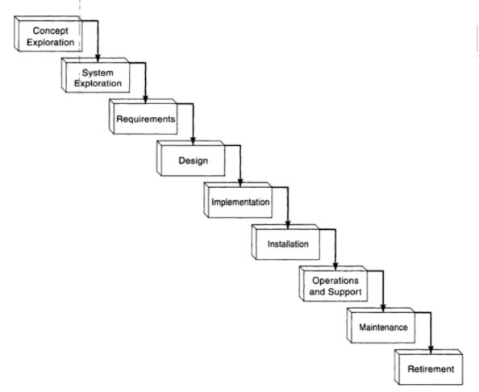
Product Development Life Cycle / Waterfall Software Life Cycle
Notes:
Futrell, Shafer, and Shafer. Quality Software Project Management.

Slide 24
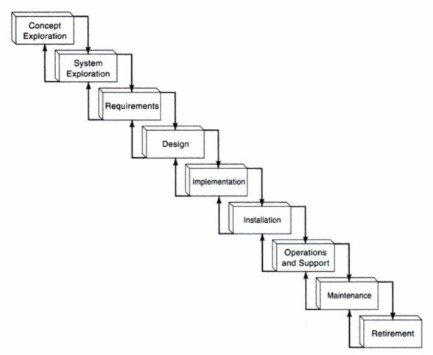
Product Development Life Cycle / Iterative Waterfall Software Life Cycle
Notes:
Futrell, Shafer, and Shafer. Quality Software Project Management.

Slide 25
Notes:
http://www.slideshare.net/NASAPMC/kellyjcrumbleyt

Slide 26
Waterfall Development Model
Develop software in sequential phases
Requirements analysis, specification, high-level design, detailed design, implementation, verification, maintenance
This is very often unrealistic
Impossible to use even for “simple” projects
Because:
Things change – project requirements, equipment, etc.
There is a lot that we do not understand when we start
When might the waterfall model be appropriate to use?
When is waterfall development “done”?

Slide 27
Spiral Development Model (Boehm)

Slide 28
Scrum Construction Lifecycle

Slide 29
Agile System Development Lifecycle (High Level View)
Notes:
Scott Ambler,

Slide 30
Agile System Development Lifecycle (Detailed View)

Slide 31
Iterative Development Models (Spiral, Agile)
Driving philosophy:
No software manufacturing
Do not know risks until development
Simple initial implementation (Agile: minimum viable product)
Iterative approach to development
Many cycles:
Gradually increasing overall cost
Provide intermediate deliverables
Motto: “Always a working system.”
When is iterative development “done”?

Slide 32
Development is only part of the life cycle, so what is beyond development?
Software Operation (and Support)
Software Maintenance
Software Retirement (or Disposal)
Operation and Maintenance is sometimes grouped together and called “O&M” (pronounced “oh and em”)
O&M manual – Operation and Maintenance Manual

Slide 33
Software Operation according to IEEE Standard 12207-1998
The purpose of the Software Operation Process is to operate the software product in its intended environment and to provide support to the customers of the software product.
As a result of the successful implementation of the Software Operation Process:
an operation strategy is defined;
conditions for correct operation of the software in its intended environment are identified and evaluated;
the software is tested and determined to operate in its intended environment;
the software is operated in its intended environment; and
assistance and consultation is provided to the customers of the software product in accordance with the agreement.
Activities and tasks?
Notes:
IEEE 12207-2008

Slide 34
Software Maintenance according to IEEE Standard 12207-1998
Operation and Maintenance are two different, but related activities, often paired together and called “O&M”
The purpose of the Software Maintenance Process is to provide cost-effective support to a delivered software product.
As a result of the successful implementation of the Software Maintenance Process:
a maintenance strategy is developed to manage modification and migration of products according to the release strategy;
the impact of changes to the existing system on organization, operations or interfaces are identified;
affected system and software documentation is updated as needed;
modified products are developed with associated tests that demonstrate that requirements are not compromised;
product upgrades are migrated to the customer’s environment; and
the system software modification is communicated to all affected parties.
Activities and tasks?
Notes:
IEEE 12207-2008

Slide 35
Software Disposal according to IEEE Standard 12207-1998
The purpose of the Software Disposal Process is to end the existence of a system’s software entity.
This process ends active support by the operation and maintenance organization, or deactivates, disassembles and removes the affected software products, consigning them to a final condition and leaving the environment in an acceptable condition. This process destroys or stores system software elements and related products in a sound manner, in accordance with legislation, agreements, organizational constraints and stakeholder requirements. Where required, it maintains records that may be monitored.
Notes:
IEEE 12207-2008

Slide 36
Software Disposal according to IEEE Standard 12207-1998
As a result of successful implementation of the Software Disposal Process:
a software disposal strategy is defined;
disposal constraints are provided as inputs to requirements;
the system's software elements are destroyed or stored;
the environment is left in an agreed-upon state; and
records allowing knowledge retention of disposal actions and any analysis of long-term impacts are available.
Activities and tasks?

Slide 37
Choice of Terminology
Software Maintenance, Maintenance Phase, or O&M are often used as an umbrella terms to cover all of three of these processes as defined by IEEE
Software Operation
Software Maintenance
Software Disposal

Slide 38
Definitions of Software Maintenance
“… change that have to be made to computer programs after they have been delivered to the customer or user.” (Martin & McClure 1983)
“… the performance of those activities required to keep a software system operational and responsive after it is accepted and placed into production.” (FIPS 1984)
“Maintenance covers the life of a software system from the time it is installed until it is phased out.” (von Mayrhauser 1990)
“Software maintenance is the process of modifying a software system or component after delivery to correct faults, improve performance, or other attributes, or adapt to a changed environment.” (IEEE 1219 1993)
“… software product undergoes modification to code and associated documentation due to a problem or the need for improvement. The objective is to modify existing software product while preserving its integrity.” (ISO/IEC 12207 1995)

Slide 39
Choice of Terminology
Software doesn’t break, it doesn’t wear out, so why maintain it?
Because:
Software is rarely perfect when delivered
Software’s operating environment changes
Software’s specification changes
Better Terms?
Long-Term (Extended) Development, because that’s what we’re really doing
Software Evolution, because products naturally evolve over time
Regardless of what we call it, it is the most expensive component of software development.

Slide 40
Why Software Must be Maintained (Schach)
Software is a model of reality. Reality changes. Software must adapt or die.
If software is found to be useful, satisfied users want to extend the functionality of the system.
Software is much cheaper to change than hardware. As a result, changes are made in software whenever possible.
Successful software survives well beyond the lifetime of the environment for which it was written. Software needs to be modified to run on new environments.
New hardware
New versions of operating systems
New operating systems / platforms
Changes to third-party dependencies (libraries, APIs, databases, services)

Slide 41
Why Is Maintenance Necessary? (Pigoski)
Correct errors
Correct design flaws
Interface with other systems
Make enhancements
Make necessary changes to system
Make changes in files or databases
Improve the design
Convert programs so that different hardware, software, systems features and telecomm facilities can be used
Prevent problems
Improve performance

Slide 42
Software Maintenance
In the software life cycle diagrams, phases of the system/software lifecycle appear to be equal length. However, this is not the case as the life cycle diagrams do not accurately reflect time.
Software maintenance can account for (consume) 80-90 percent of the total effort expended on a system in its lifetime.
Failures continue to be discovered in software for years.
Often, our first job upon graduating is maintenance.
Notes:
http://agile.csc.ncsu.edu/SEMaterials/MaintenanceRefactoring.pdf

Slide 43
The Noble Art of Maintenance Programming (Jeff Atwood, Coding Horror)
Mention the words “maintenance programming” to a group of developers and they will recoil in horror.
Maintenance programming is widely viewed as janitorial work.
And that is an unfair characterization.
Atwood’s points:
We should probably have our best developers doing software maintenance.
At some point, you have to bite the bullet and reset the foundation so you have a stable platform to build on.
Software maintenance, like Rodney Dangerfield, gets no respect. It’s time we changed that perception.
Notes:
http://blog.codinghorror.com/the-noble-art-of-maintenance-programming/

Slide 44
Software Conflict 2.0: The Art and Science of Software Engineering (Robert Glass)
Software maintenance is…
Intellectually complex – it requires innovation while placing severe constraints on the innovator
Technically difficult – the maintainer must be able to work with a concept and a design and its code all at the same time
Unfair – the maintainer never gets all the things that the maintainer needs, such as documentation
No-win – the maintainer only sees people who have problems
Dirty work – the maintainer must work at the grubby level of detailed coding
Living in the past - the code was probably written by someone else before they got good at it
Conservative – the going motto for maintainance is “if it ain’t broke, don’t fix it”

Slide 45
Software Maintenance
Very little is written in this field.
Few books, many of them outdated.
Little attention paid, although a very expensive, long-lasting activity.
Inconsistent definitions and terminology.
Does not fit into some software life cycle models or business models.
Often considered a post-delivery activity, but pre-delivery development activities drive what maintenance will look like.
Is it necessary if software developers do their work correctly?
Who should be responsible for maintenance?

Slide 46
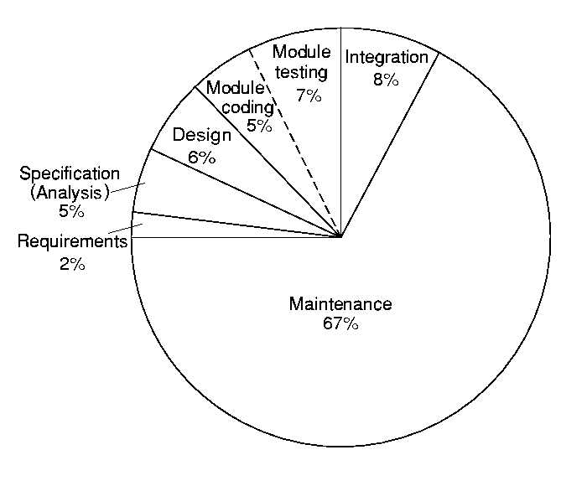
Relative Costs of the Phases of the Life Cycle
Notes:
Schach, p. 11

Slide 47
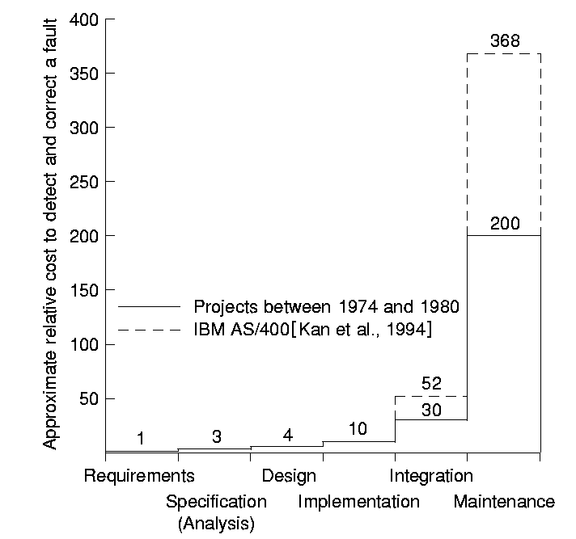
Cost to Detect and Correct a Fault Increases by Phase
Say the problem is in the requirements. If you found it immediately, it costs $x to fix
But you find it later in the life cycle, how much more does it cost to fix?
4x as expensive if found and corrected in design
10x as expensive in implementation
30–52x as expensive in integration
200–368x as expensive in maintenance
Notes:
Schach, p. 14

Slide 48
Cost versus Ease of Change
Notes:
Commitment, system-specific knowledge, and cost (source: B.S. Blanchard & W.J. Fabrycky, Systems Engineering and Analysis, 3rd Ed., Prentice Hall, 1998, Figure 2.11)

Slide 49
Total Cost Visibility
Notes:
Total cost visibility (source: B.S. Blanchard & W.J. Fabrycky, Systems Engineering and Analysis, 3rd Ed., Prentice Hall, NJ, 1998, Figure 17.2)

Slide 50
System Operation
Will bring unforeseen requirements to light.
Users may use the system in a way which is not anticipated by system designers.
May reveal problems in the interaction with other systems.
Physical problems of incompatibility
Data conversion problems
Increased operator error rate because of inconsistent interfaces

Slide 51
System Evolution
Large systems have a long lifetime. They must evolve to meet changing requirements.
Evolution is inherently costly.
Changes must be analyzed from a technical and business perspective.
Sub-systems interact so unanticipated problems can arise.
There is rarely a rationale for original design decisions.
System structure is corrupted as changes are made to it.
Existing systems which must be maintained are called legacy systems.

Slide 52
Why is Maintenance So Expensive?
Good software is maintained. Bad software is discarded.
Success has a long-term cost!
Happy users want more.
Team stability
Contractual responsibility – developers who are not responsible for maintenance don’t care about maintenance
Staff skills – newbie, unskilled
Program age and structure

Slide 53
Remember a Significant Risk Area
Software developer does not understand the development and maintenance problems
Software developer needs to have strong debugging and interpersonal skills to perform corrective maintenance
Documentation obsolete or non-existent
Fix without breaking anything else
Test to make sure fix works and no regression faults have been introduced
Our goal is to recognize problems and sharpen these skills

Slide 54
What Factors Influence Maintenance Costs?
Program comprehension
Cognitive labor-intense activity
Development budget constraints
Development schedule constraints
How activities are done (or not done) during the development phase directly affect the cost of maintenance.
Maintainers spend time coding functions that should have been completed during development, but may have been cut due to budget or schedule constraints.
Development costs remain within budget while maintenance costs increase.

Slide 55
Categories of Maintenance and Costs
Different categories (types) of maintenance
Corrective maintenance: Fix defects after release
Perfective maintenance: Enhance to add new features etc.
Adaptive maintenance: Make it work in changing environment
How much of total maintenance costs goes to each?
75% corrective, 15% perfective, 10% adaptive
60% corrective, 20% perfective, 20% adaptive
20% corrective, 60% perfective, 20% adaptive
40% corrective, 20% perfective, 40% adaptive

Slide 56
Categories of Maintenance and Costs
Different categories (types) of maintenance
Corrective maintenance: Fix defects after release – 20% of total maintenance
Perfective maintenance: Enhance to add new features etc. – 60%
Adaptive maintenance: Make it work in changing environment – 20%
IEEE Standard 14764-2006, ISO/IEC International Standard for Software Engineering – Software Lifecycle Processes – Maintenance, includes a fourth category
Preventative maintenance: modification of software to correct latent faults before they become operational faults

Slide 57
Categories of Software Maintenance (Pigoski)
Corrective
Changes necessitated by actual errors.
Adaptive
Changes that result from modifications to the operating environment of the software system.
Perfective (Improvement)
Changes made to meet expanding needs of user.
Preventive
Maintenance performed for the purpose of preventing problems before they occur.

Slide 58
Categories of Software Maintenance (Pigoski) – Car Analogy
Corrective
The system does not operate as it was designed or advertised.
Fix a flat tire.
Adaptive
Changes made to keep pace with the environment.
Upgrade an engine to accommodate new anti-smog law.
Perfective (Improvement)
Changes made to accommodate the needs of user.
Add a spoiler for better aerodynamics and styling.
Preventive
Fix the problem before it occurs.
Change the oil so that the engine does not seize.

Slide 59
Software Maintenance Categories (SWEBOK v3)
 | Correction | Enhancement
Proactive | Preventive | Perfective
Reactive | Corrective | Adaptive
Notes:
SWEBOKv3.pdf, p. 5-4

Slide 60
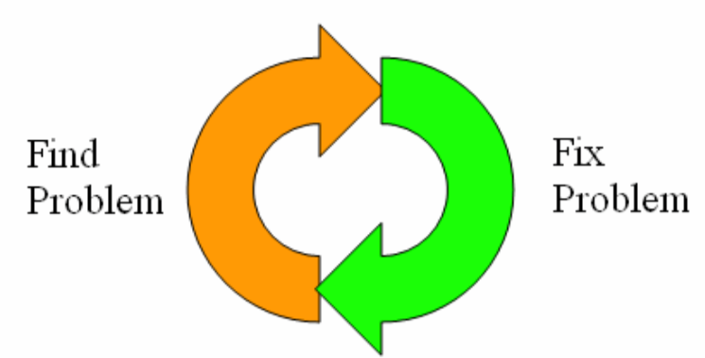
Software Maintenance is Not a Series of Quick Fixes
Requirements, design, and code become inconsistent.
Software aging is accelerated.
Unforeseen ripple effects impact system quality.
Small changes are 40 times more likely to cause problems.
Notes:
http://agile.csc.ncsu.edu/SEMaterials/MaintenanceRefactoring.pdf

Slide 61
Breakdown of Topics for the Software Maintenance Knowledge Areas (SWEBOK)
Software Maintenance Fundamentals
Definition and Terminology
Nature of Maintenance
Key Issues in Software Maintenance
Technical Issues
Management Issues
Need for Maintenance
Majority of the Maintenance Costs
Evolution of Software
Categories of Maintenance
Maintenance Cost Estimation
Software Maintenance Measurement
Maintenance Process
Maintenance Processes
Maintenance Activities
Techniques for Maintenance
Program Comprehension
Reengineering
Reverse Engineering
Migration
Retirement
Software Maintenance Tools
Notes:
SWEBOKv3.pdf, p. 5-2

Slide 62
Questions?

